Slide 1
Lab Seminar
2024.05.13
16:00(UTC+9)
Seungwan Woo (UST)

Slide 2
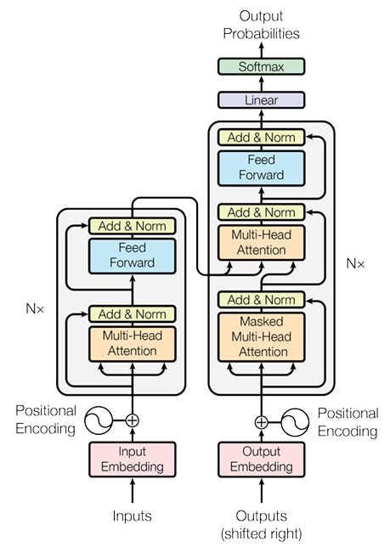
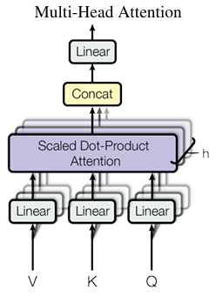
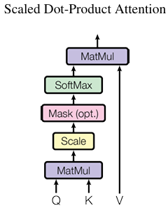
Vaswani, A., Shazeer, N., Parmar, N., Uszkoreit, J., Jones, L., Gomez, A. N., ... & Polosukhin, I. (2017). Attention is all you need. Advances in neural information processing systems, 30.
Review

Slide 3
Vaswani, A., Shazeer, N., Parmar, N., Uszkoreit, J., Jones, L., Gomez, A. N., ... & Polosukhin, I. (2017). Attention is all you need. Advances in neural information processing systems, 30.
Review – Query, Key, Value
Query: Currently processing token vector.
Key: A vector use to measure the similarity between the query and each token
Value: Vector used to calculate the token’s weight based on Attention Score
Attention!
Value
The
animal
didn’t
cross
the
street
because
it
was
to
tired
Attention Score
The
animal
didn’t
cross
the
street
because
it
was
to
tired
Key
The
animal
didn’t
cross
the
street
because
it
was
to
tired
Token
The
animal
didn’t
cross
the
street
because
it
was
to
tired
Query #8

Slide 4
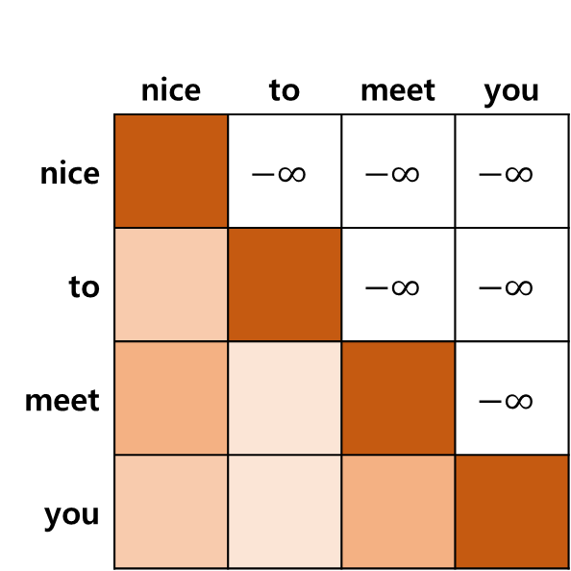
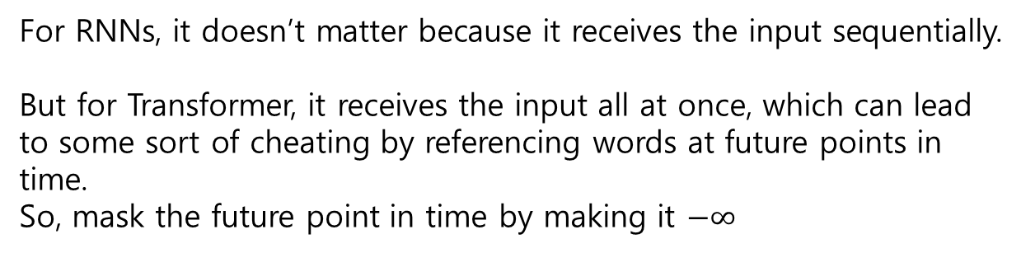
Vaswani, A., Shazeer, N., Parmar, N., Uszkoreit, J., Jones, L., Gomez, A. N., ... & Polosukhin, I. (2017). Attention is all you need. Advances in neural information processing systems, 30.
Review – Masked Attention
Masked Attention
For RNNs, it doesn’t matter because it receives the input sequentially.
But for Transformer, it receives the input all at once, which can lead to some sort of cheating by referencing words at future points in time.
So, mask the future point in time by making it $−∞$
 | nice | to | meet | you
nice |  | $$−∞$$ | $$−∞$$ | $$−∞$$
to |  |  | $$−∞$$ | $$−∞$$
meet |  |  |  | $$−∞$$
you

Slide 5
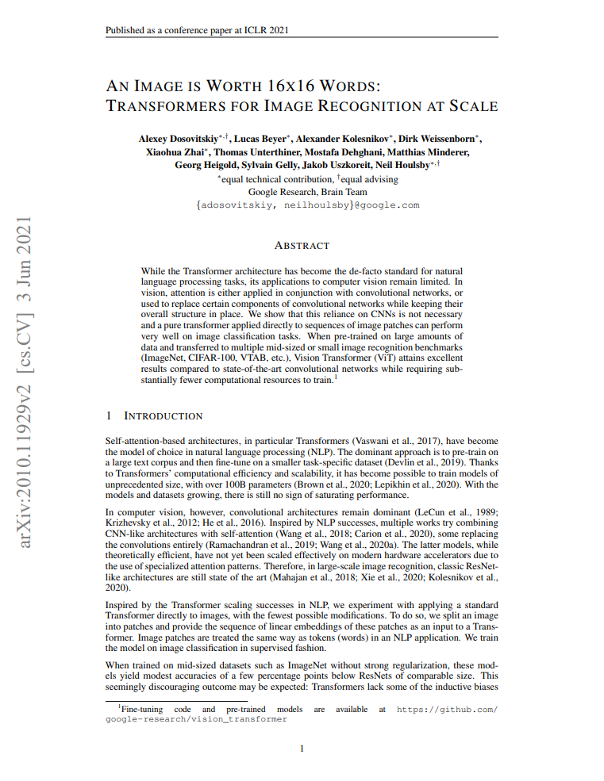
Introduction
AN IMAGE IS WORTH 16X16 WORDS: TRANSFORMERS FOR IMAGE RECOGNITION AT SCALE
ICLR 2021
Google Brain
Citation: 35,335

Slide 6
Background
Michelucci, Umberto. "An introduction to autoencoders." arXiv preprint arXiv:2201.03898 (2022).
The Transformers has become the de-facto standard in NLP.
However, CNN remains dominant in Computer vision.
Inspired by the Transformer success in NLP, the authors apply a standard Transformer to image classification in Computer vision.
To do so, authors are split an image into patches and provide the sequence of linear embeddings of these patches as an input to a Transformer.
This is same way as tokens(words) in an NLP application.

Slide 7
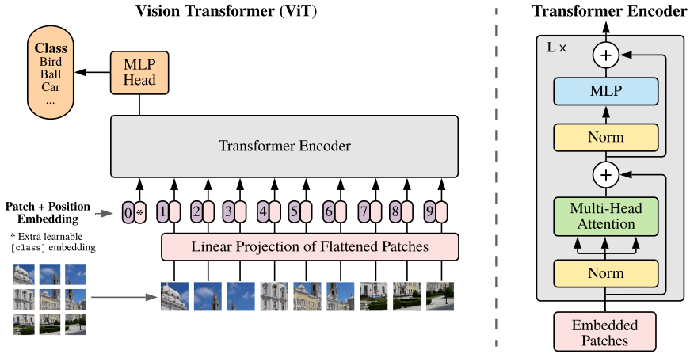
Dosovitskiy, Alexey, et al. "An image is worth 16x16 words: Transformers for image recognition at scale." arXiv preprint arXiv:2010.11929 (2020).
Method

Slide 8










Dosovitskiy, Alexey, et al. "An image is worth 16x16 words: Transformers for image recognition at scale." arXiv preprint arXiv:2010.11929 (2020).
Method
<Input>
Reshaping
(255X255X3)
9(85X85X3)

Slide 9
Dosovitskiy, Alexey, et al. "An image is worth 16x16 words: Transformers for image recognition at scale." arXiv preprint arXiv:2010.11929 (2020).
Method
1
2
3
4
5
6
7
8
9
9(85X85X3)
1
2
3
4
5
6
7
8
9

Slide 10
Dosovitskiy, Alexey, et al. "An image is worth 16x16 words: Transformers for image recognition at scale." arXiv preprint arXiv:2010.11929 (2020).
Method
9
8
7
4
6
1
5
2
3
9XD
1
2
3
4
5
6
7
8
9

Slide 11
Dosovitskiy, Alexey, et al. "An image is worth 16x16 words: Transformers for image recognition at scale." arXiv preprint arXiv:2010.11929 (2020).
Method
0
class token
9
8
7
4
6
1
5
2
3
(9+1)XD
1
2
3
4
5
6
7
8
9

Slide 12
Dosovitskiy, Alexey, et al. "An image is worth 16x16 words: Transformers for image recognition at scale." arXiv preprint arXiv:2010.11929 (2020).
Method
0
class token
9
6
8
4
7
1
5
2
3
(9+1)XD
Patch embedding
10XD
Patch + Positional embedding
(9+1)XD
Positional embedding

Slide 13
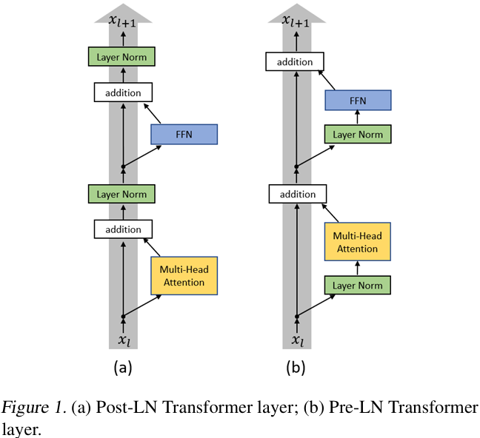
Xiong, Ruibin, et al. "On layer normalization in the transformer architecture." International Conference on Machine Learning. PMLR, 2020.
Method
Why does ViT uses pre-LN?

Slide 14
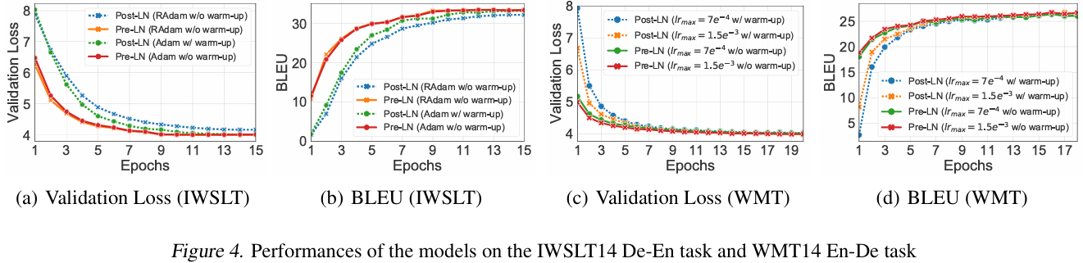
Xiong, Ruibin, et al. "On layer normalization in the transformer architecture." International Conference on Machine Learning. PMLR, 2020.
Method
Because pre-LN is faster than pro-LN and doesn’t require a warm-up in learning rate!
Learning rate warm-up: A technique for slowly increasing the learning rate during the initial training phase of a deep learning model. It is used because a high initial training rate can lead to inaccurate predictions.

Slide 15
Dosovitskiy, Alexey, et al. "An image is worth 16x16 words: Transformers for image recognition at scale." arXiv preprint arXiv:2010.11929 (2020).
Method
10XD
Patch + Positional embedding
10XD
Normalized embedding

Slide 16
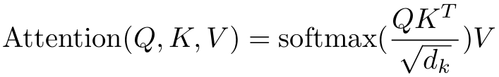
Dosovitskiy, Alexey, et al. "An image is worth 16x16 words: Transformers for image recognition at scale." arXiv preprint arXiv:2010.11929 (2020).
Method
10XD
Normalized embedding
10XD
Query
10X10
Attention score
10XD
Key
10XD
Self-Attention Value
10XD
Value

Slide 17
Dosovitskiy, Alexey, et al. "An image is worth 16x16 words: Transformers for image recognition at scale." arXiv preprint arXiv:2010.11929 (2020).
Method
Norm
MLP
10XD
Self-Attention Value
Class token
(9+1)XD
Transformer Output

Slide 18
Dosovitskiy, Alexey, et al. "An image is worth 16x16 words: Transformers for image recognition at scale." arXiv preprint arXiv:2010.11929 (2020).
Method
Classification using only the Class token
MLP
Bird
Class token
(9+1)XD
Transformer Output

Slide 19
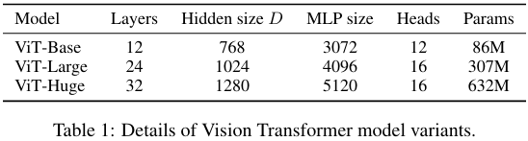
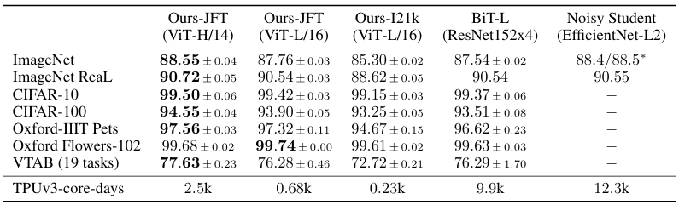
Dosovitskiy, Alexey, et al. "An image is worth 16x16 words: Transformers for image recognition at scale." arXiv preprint arXiv:2010.11929 (2020).
Results

Slide 20
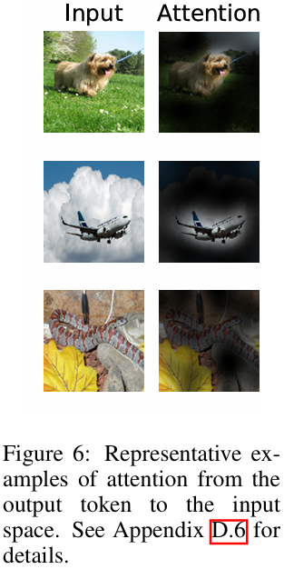
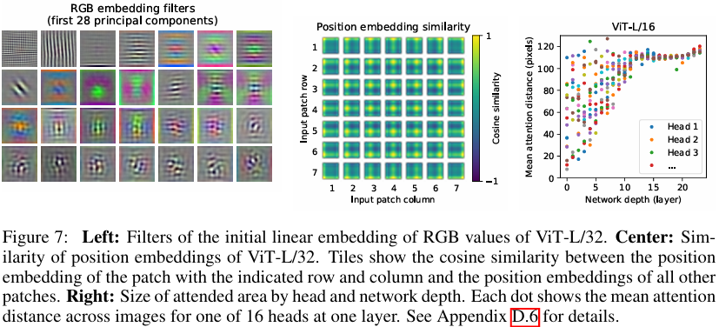
Dosovitskiy, Alexey, et al. "An image is worth 16x16 words: Transformers for image recognition at scale." arXiv preprint arXiv:2010.11929 (2020).
Results

Slide 21
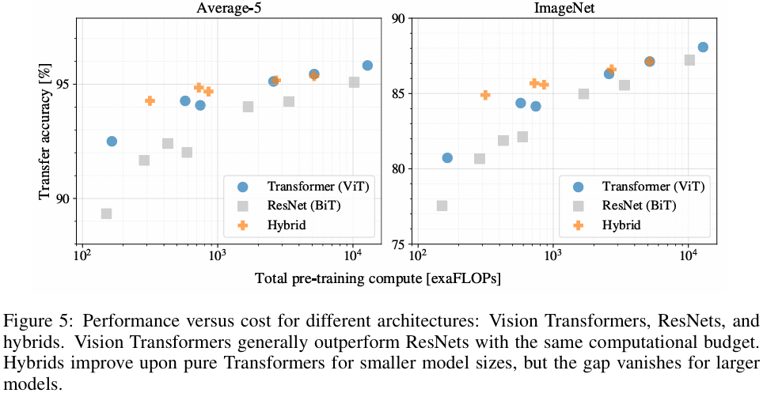
Dosovitskiy, Alexey, et al. "An image is worth 16x16 words: Transformers for image recognition at scale." arXiv preprint arXiv:2010.11929 (2020).
Results

Slide 22
Conclusion
Why I reviewed this paper?
Transformer and ViT are very important papers in NLP and vision.
They are used in many studies, and I reviewed them as a background study to make it easier to understand the papers.
I wish to do research on data generation for learning. Because I think we can learn from data generated in situations where there is limited data to apply AI in various fields.

Slide 23
Thank you!

